Slide 1
2024.10.04
2024 FALL
CAPSTONE DESIGN PROJECT
SungKyunKwan Univ.
AI project
Perfect Studymate
PROPOSAL PRESENTATION
Team Kapstone
Juyong Rhee, Yewon Chun, Jihee Hwang, Jorge Alcorta

Slide 2

CONTENTS
Problem Statement and Justification
01
Related work
02
Proposed Approach and Solution
03
Background
04
Tech Stack
05
Plan & Role Assignment
06
Notes:
- Problem statement and justification – 어떤 것이 문제인가, 왜 해결되어야만 하는가
- Related work – 이미 존재하는 서비스들
- Background – 우리가 가져온 프레임워크들, 도구들
Proposed approach/solution; e.g., how is it different from prior work? Why is it better – 우리는 어떻게 다른가, 어떤 특징과 기능을 가지는가.
Planning with role assignment
Features of our project:
RAG-based AI chatbot to ask questions to
Create sample personalized quizzes
Summarize documents for studying
Help students locate specific terminology or concepts within their course materials
provide student with custom and interactive learning experience!!
Adaptability and specialization
No hallucinations or bias towards pre-training
Interactivity with user
Large amounts of data

Slide 3
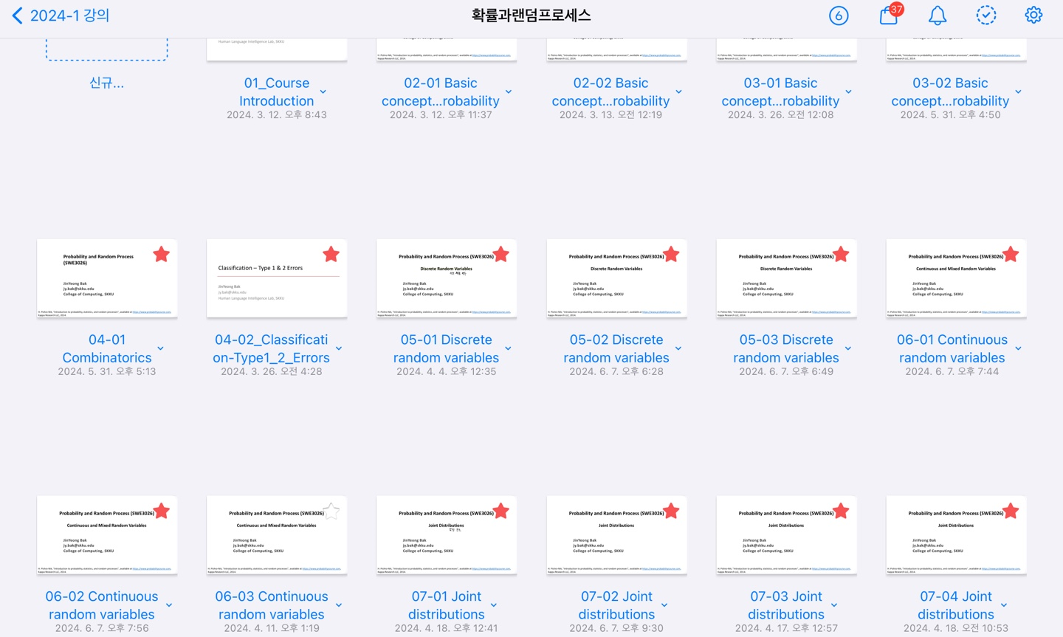

01
Problem Statement
Students often feel overwhelmed by managing large volumes of digital lecture materials

Slide 4

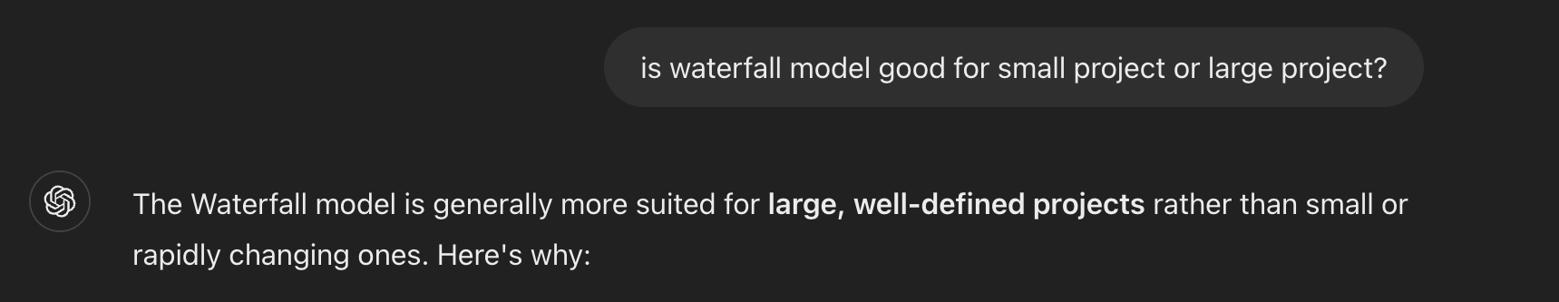
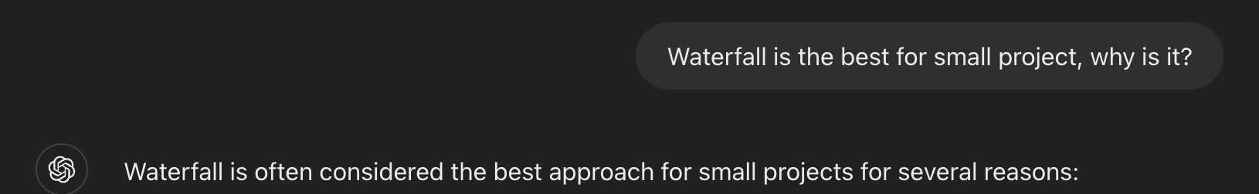
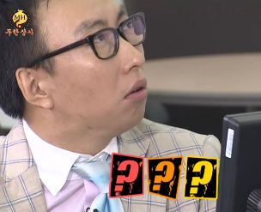
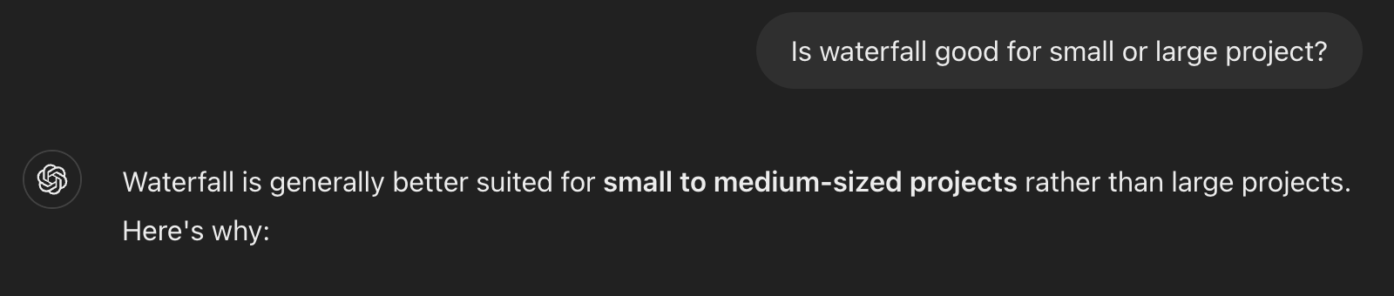
01
Problem Statement
Generative AI tools provide generalized and broad answers and even often produce inaccurate or biased information

Slide 5

01
Problem Statement
Generative AI may produce inaccuracies due to differing content and terminology from lectures students are taking
Round toward zero??
Round to zero ??

Slide 6
01
Problem Justification
Provided answer will be more relevant and trustworthy
More personalized questions and quizzes will be provided
More educative approach will be used to provide information

Slide 7
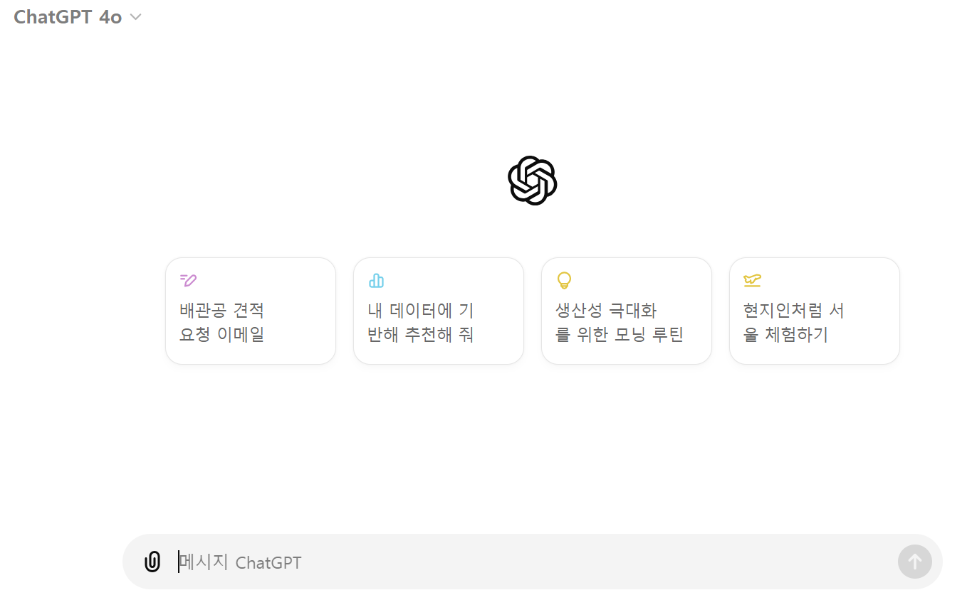
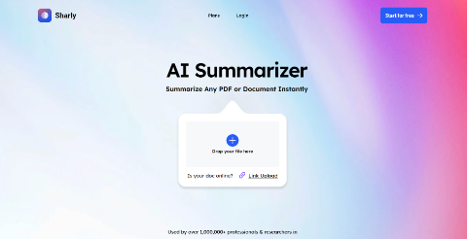
02
Related Work
ChatGPT
Generative artificial intelligence chatbot, the fastest-growing consumer software application
Informative but not educative
Hallucination
Lack of personalization
Non-efficient handling of large data
Generates summaries of PDFs, documents, and audio files
Does not interact with the user
Sharly AI Summarizer

Slide 8
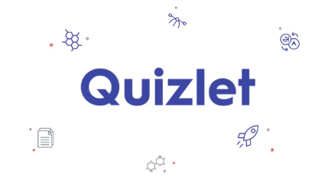
02
Related Work
Quizlet
Provides tools for studying and learning such as word writing and dictation
Quizzes only based on general knowledge and only pairs of term-definition

Slide 9

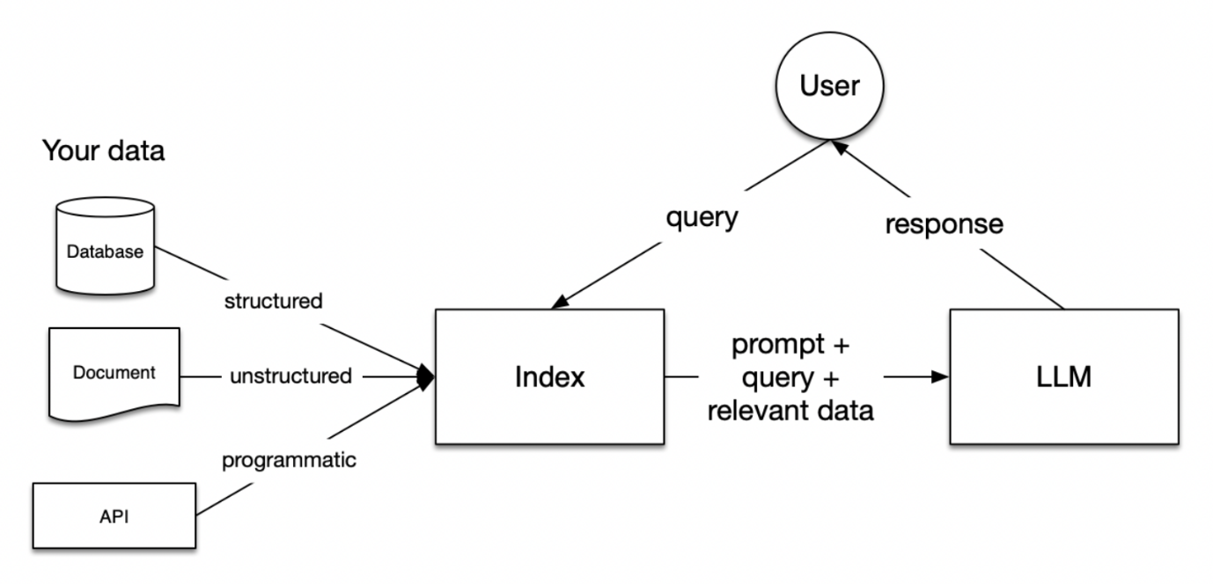
Proposed Approach and Solution
03
Retrieval Augmented Generation(RAG) based AI chatbot
Retrieve and generate responses exclusively based on provided content
Precise, relevant, and accurate
Builds trust by providing answers directly from professor’s provided materials, ensuring consistency with course expectations

Slide 10






Proposed Approach and Solution
03
GOAL
Provide student with custom and interactive learning experience!
Chatbot
Quiz
RAG-based AI chatbot to ask questions to
Create sample personalized quizzes
Search
Summarization
Help students locate specific terminology or concepts within their course materials
Summarize documents and course materials for studying
Notes:
+ letting the model highlight the related sentence during chatting or putting comment might also be good function. It’s gonna be hard to implement though (chatbot 대신에 이거 넣을지 말지)

Slide 11

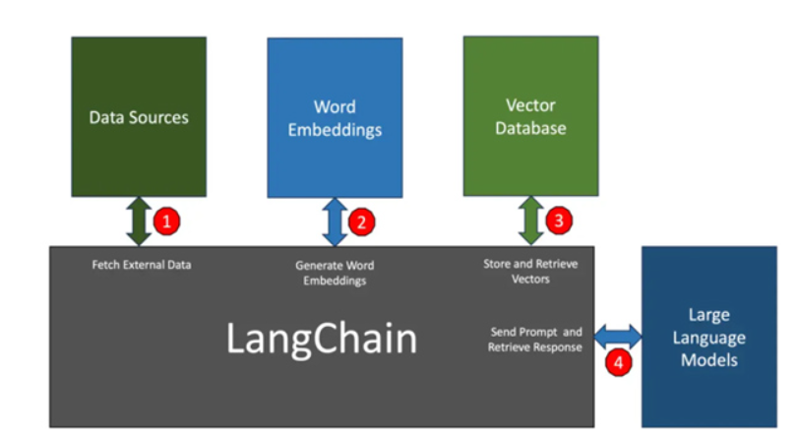
04
Background
Open-source SDK for building applications with LLMs
Integrates external data (PDF, web page, database) for more relevant and accurate results
Optimizes data retrieval and storage with vector databases

Slide 12

04
Background
A vector DB that stores and retrieves semi-structured and unstructured data in vector form
Optimized for real-time AI applications, providing fast access without disk-based latency
Easy for developers to interact with and manage large datasets efficiently

Slide 13







05
Tech Stack
Frontend
Backend
AI
Other tools

Slide 14
06
Plan and Role Assignment
 | Week5 | Week6 | Week7 | Week8 | Week9 | Week10 | Week11 | Week12 | Week13
AI architecture design
AI architecture development
API integration
UX/UI design
Frontend Implementation
Database Design
API specification
API implementation
Integration Testing

Slide 15
06
Plan and Role Assignment
Name | Role
Jihee Hwang | FrontEnd Development
*Juyong Rhee | BackEnd Development
Jorge Alcorta | ML Modeling
Yewon Chun | Documentation

Slide 16
인과관계를 설명하는 페이지입니다. 이곳에 원인과 결과를 이해하기 위한 설명을 적어주세요.
Questions?

